Slide 1

Introduction to Bankruptcy Law and the Bankruptcy System:
An Educational Primer for State Courts
[Template Presentation For Educational Use]
This template presentation, provided by
the Federal Judicial Center, combines, edits, and expands presentations given by bankruptcy judges and state trial court judges. Contact Jason A. Cantone, at fedstate@fjc.gov, for more information.
Notes:
This presentation was greatly benefitted by the following individuals, who reviewed an earlier draft of the presentation: Hon. Shon Hastings, Hon. Craig Whitley, Hon. Cate Furay, Hon. Charles L. Nail, Jr., Hon. Ashely Chan, Hon. Robert Kressel, Hon. Robert Drain, Hon. Diane Finkle, Hon. Robert Faris, Elizabeth Wiggins, and Brian Lynch. The presentation utilizes and expands on prior educational materials provided alongside interviews held by Dr. Jason Cantone with: Hon. Dan Collins, Hon. Brian Davis, Hon. Robert Faris, Hon. Cate Furay, Hon. Martin Glenn, Hon. A. Benjamin Goldgar, Hon. Mary Gorman, Hon. Laurel Isicoff, Hon. Catherine McEwen, Hon. Robyn Moberly, Hon. Mindy Mora, Hon. Chris Panos, Hon. Laura Taylor, and Ann M. Anderson. This presentation was made better by all of these individuals, as well as the Judicial Conference Committee on Federal-State Jurisdiction.

Slide 2


Content Note
This presentation only addresses the bankruptcy discharge. A full presentation with all six topics (bankruptcy overview; automatic stay; bankruptcy discharge; family law; foreclosure; additional considerations) is available at fjc.gov/fedstate, as well as separate presentations for each of those topics.
Notes:
If you would like a Powerpoint that includes the full presentation or the topics provided in the note, please visit fjc.gov/fedstate.

Slide 3
The Bankruptcy Discharge

Slide 4
The Bankruptcy Discharge
Section 524(a): A bankruptcy discharge voids a judgment to the extent that such judgment is a determination of personal liability for unsecured debt that was actually discharged under the relevant chapter.
The discharge is a permanent statutory injunction that
  prevents any legal action or communication with the debtor for the purpose of collecting a discharged debt
  does not protect codebtors

Slide 5
If there is a dispute about whether a debt in an action was discharged, should you resolve the issue?
Only bankruptcy courts can determine whether to grant or deny a discharge in bankruptcy.
In many circuits, if a bankruptcy court later disagrees with the determination that it doesn’t apply, the order will be declared void as being in violation of the stay.

Slide 6
If there is a dispute about whether a debt in an action was discharged, should you resolve the issue?
State courts have concurrent jurisdiction to interpret a plan of reorganization.
State courts may have concurrent jurisdiction to hear and resolve the question provided its basis is not one of the types reserved exclusively to the bankruptcy court.

Slide 7
Discharge of Secured Debts
The discharge only affects personal liability for debt.
Liens “ride through” bankruptcy.
Only deficiency liability is extinguished.
Lenders must be careful not to violate the discharge when communicating with discharged debtors.

Slide 8
Non-dischargeable Debts
11 U.S.C. §523
Category One
Sixteen types in this category, including
  recent taxes and related penalties
  debts not scheduled in bankruptcy case, except in a “no-asset” case
  domestic support obligations
  death or personal injury caused by drunk driving, boating, or flying
  fines, penalties, and forfeitures payable to and for the benefit of a governmental unit
  federal restitution awards
  student loans (unless nondischarge would impose undue hardship on debtor and dependents)
  fees between filing of bankruptcy and loss of both title and possession by condo owner

Slide 9
Non-dischargeable Debts
11 U.S.C. §523
Category Two
Three types of debts in this category. They are not self-effectuating like those listed in Category One.
  fraud of specified kinds
  fraud or defalcation by a fiduciary, embezzlement, or larceny
  willful and malicious injury to person or property

Slide 10
Preclusion and the Discharge
Preclusion principles apply in bankruptcy
State court finding of common-law fraud, award of punitive damages, etc., may result in nondischargeability
Precise findings are critical in the order, judgment, or jury verdict form

Slide 11
Reaffirmation Agreements
A Chapter 7 debtor may waive discharge of a particular debt by entering into a reaffirmation agreement.
  In general, a debtor will only reaffirm debts secured by a house or car.
11 U.S.C.§524(c) imposes many requirements for creating an enforceable reaffirmation agreement.
  The debtor is given a period of time to rescind.
A reaffirmation agreement may be enforced in any appropriate court after the automatic stay is lifted and is not subject to the discharge injunction.

Slide 12
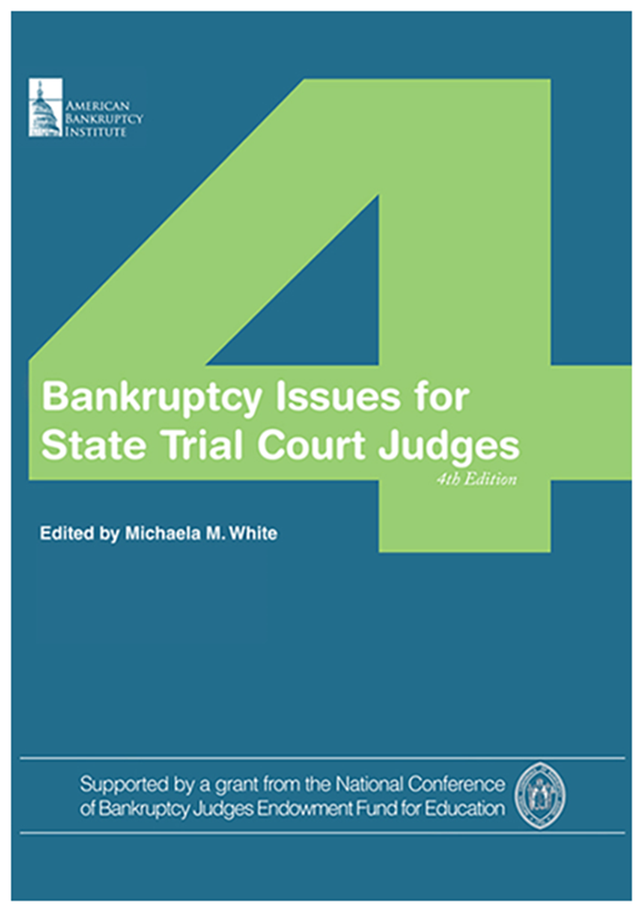
Additional
Resources
Federal Judicial Center website on federal-state cooperation: https://fjc.gov/fedstate
National Center for State Courts resource guide on foreclosures: https://www.ncsc.org/Topics/Financial/Foreclosures/Resource-Guide.aspx

Slide 13
Thank You
This presentation was organized
by Federal Judicial Center Senior Research Associate Jason A. Cantone, with considerable assistance by a number of federal and state judges and court personnel (see note for slide 1).
Questions about the presentation and its use can be directed to
Dr. Cantone, at fedstate@fjc.gov. We would also like to hear from you if you find it helpful or have any recommendations to improve it.

